Slide 1
Data Visualization in R

Slide 2
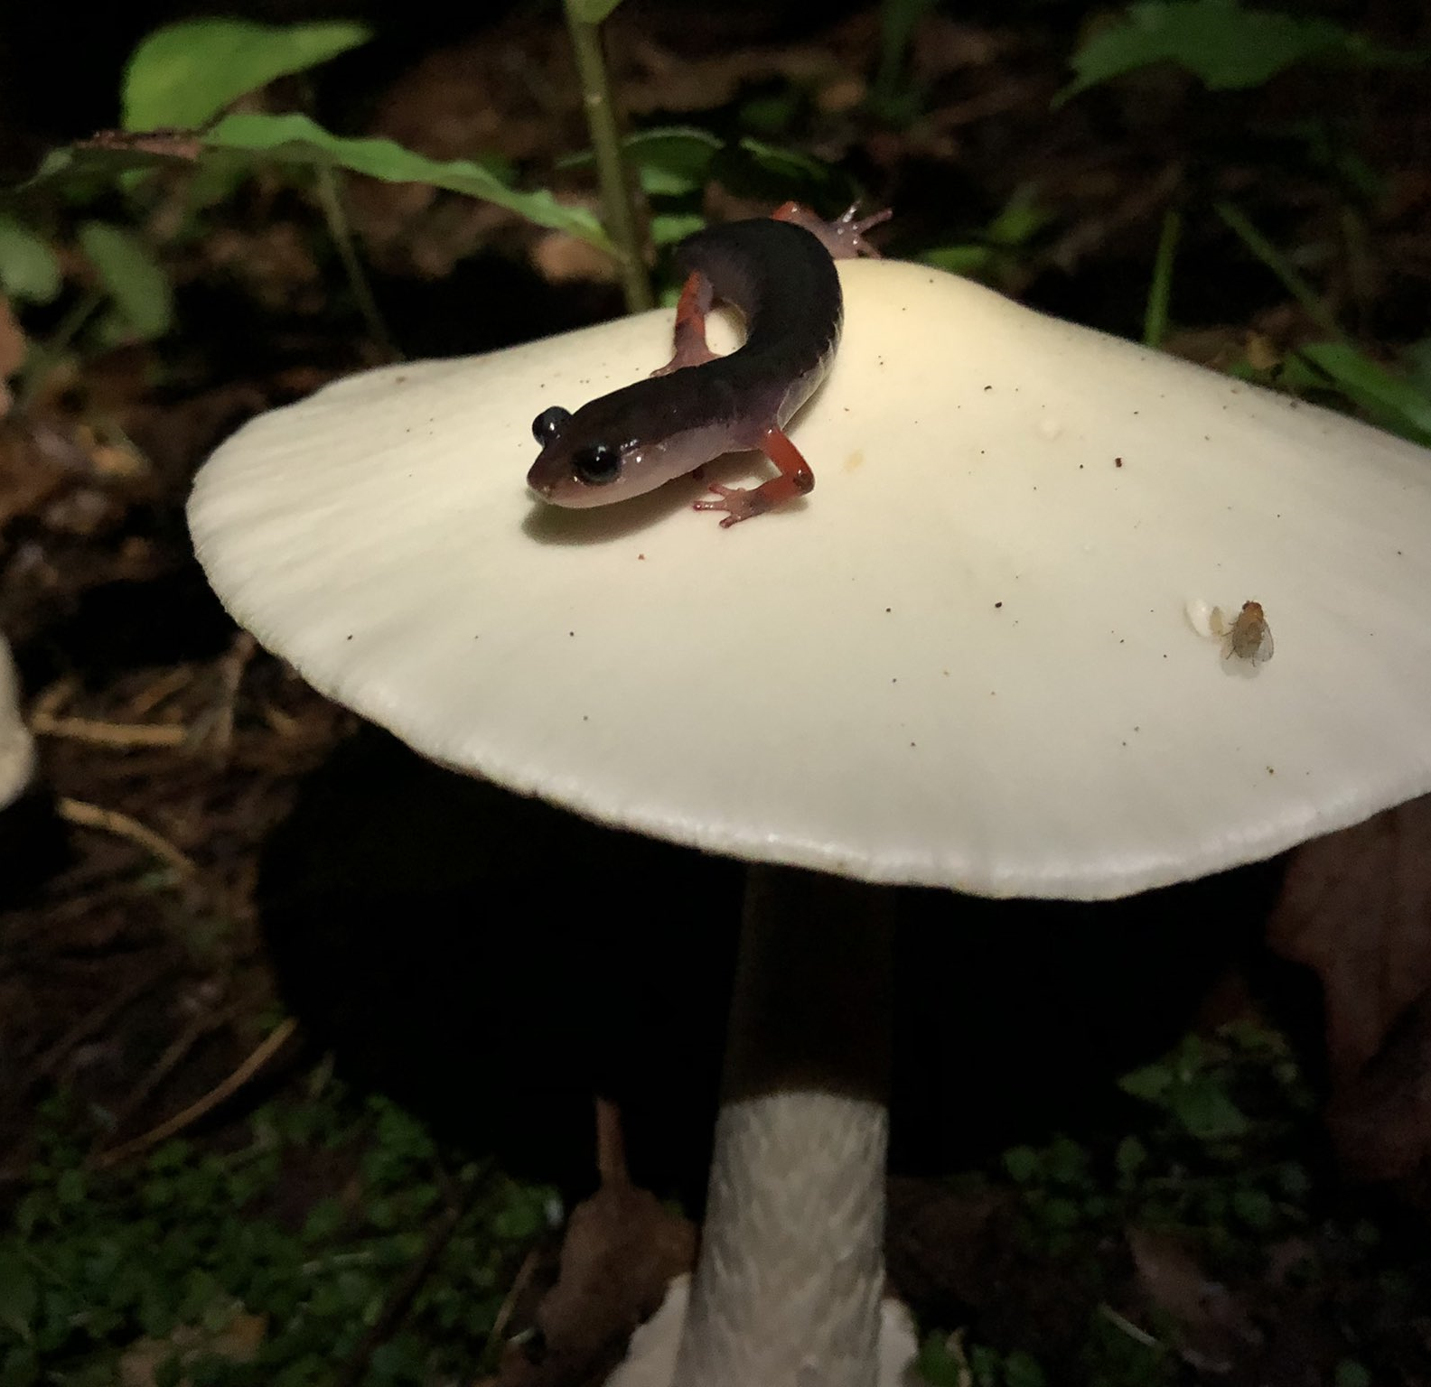
About Myself
My research interests are host hybridization and disease risk.
I use `R` in my research to:
analyze data from the field and lab
map out hotspots of disease risk
predict species distributions
help "future-me" remember what I did
I mostly work with salamanders and their gastro-intestinal parasites –
My contact info is tj.odom@uga.edu

Slide 3
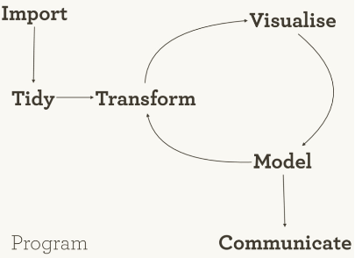
Review of past workshops
iterate a calculation
simulate populations
write a function
create an HTML doc with code and commentary
write code following best practices
calculate summary statistics of a dataset
create a figure from data

Slide 4
Outline
You should be able to...
customize figures
code a t-test
code a correlation
code a linear regression

Slide 5
Outline
**Topics**
Approach to visualizations
`ggplot` review
Plotting challenge
*Break*
Inferential statistics
Wrap Up

Slide 6
Approach to visualization
Visualizations are useful for **data exploration** and **presentation**
Characteristics of data exploration visualizations:
* complex
* minimally annotated
* potentially patternless
Should be avoided for presentation visualizations.

Slide 7
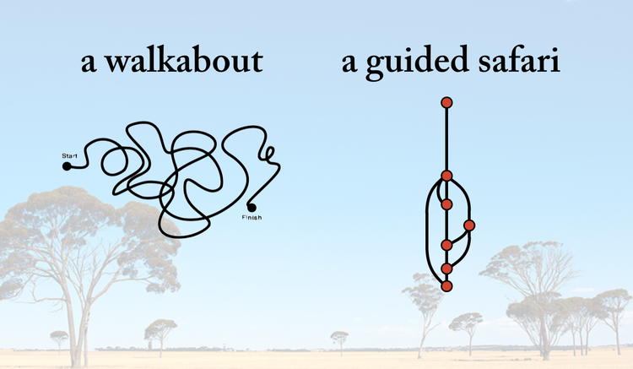
Presentation visualizations
Should guide the reader through the research.

Slide 8
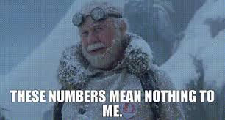
We've spent a bit of time making figures for exploration, but haven't touched on presentation quality visualizations.
**What are some characteristics of a good presentation visualization?**

Slide 9
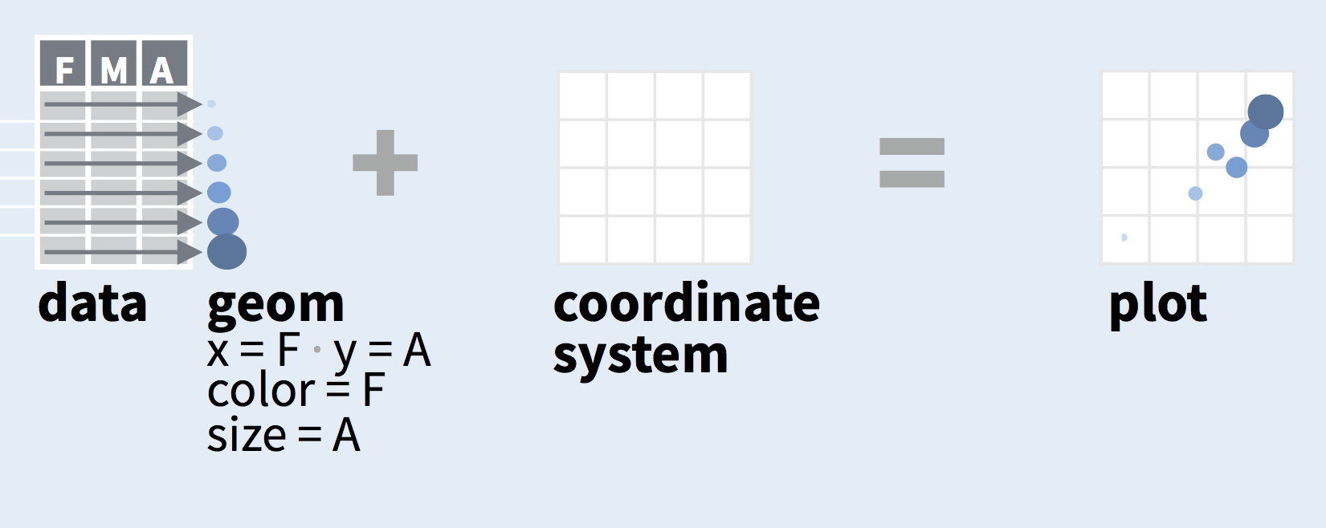
Review of ggplot
plots are divided into 3 fundamental parts **plot = data + Aesthetics + geometry**

Slide 10
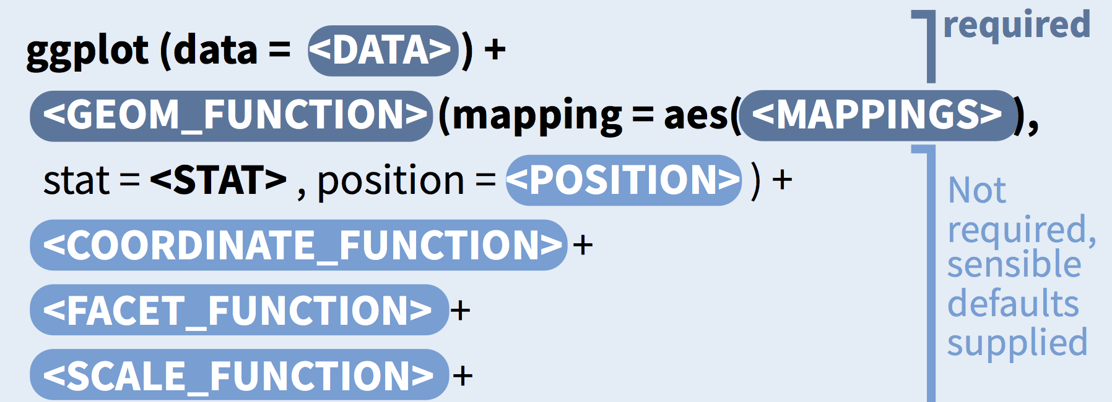
Minimum Arguments
Visualizations are useful for **data exploration** and **presentation**
Characteristics of data exploration visualizations:
* complex
* minimally annotated
* potentially patternless
Should be avoided for presentation visualizations.

Slide 11
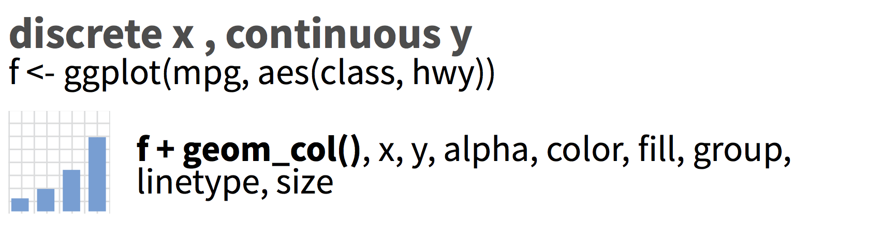
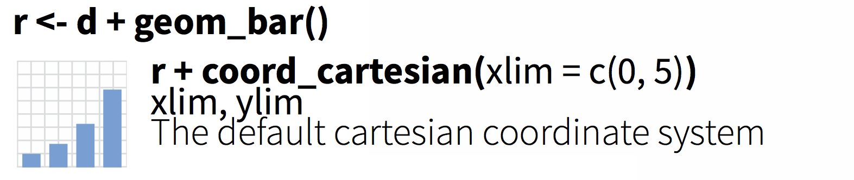
Minimum Arguments

Slide 12
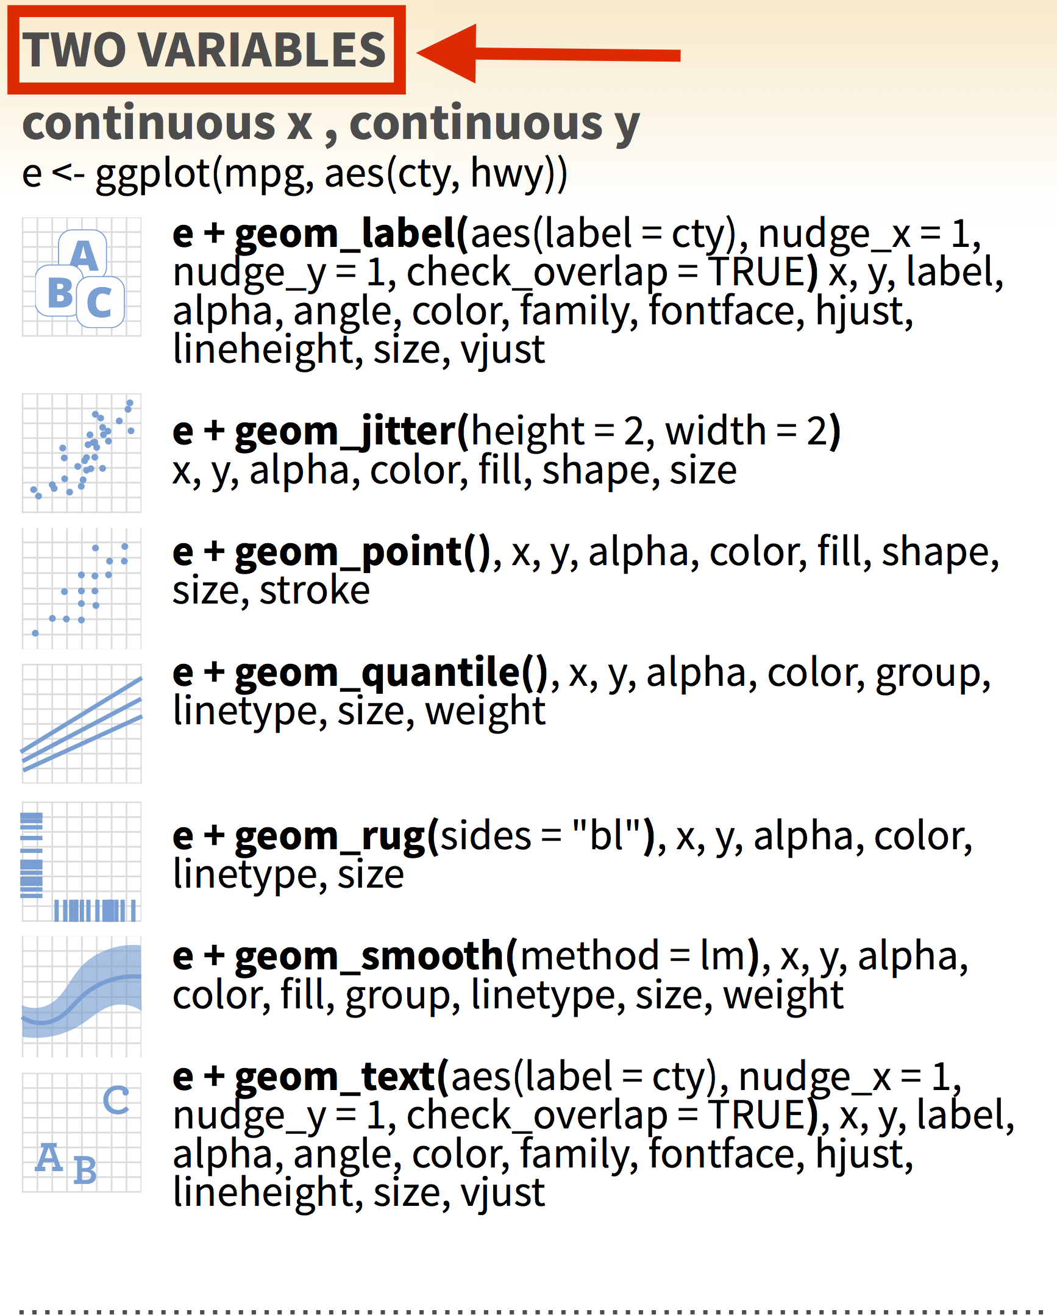
Using the ggplot2 cheat sheet
The cheat sheet reads like a choose your own adventure book
Based on your data, go to the One, Two or Three variables section.

Slide 13
Using the ggplot2 cheat sheet
The cheat sheet reads like a choose your own adventure book
Based on your data, go to the One, Two or Three variables section.
If two variables decide if x and y are continuous.

Slide 14
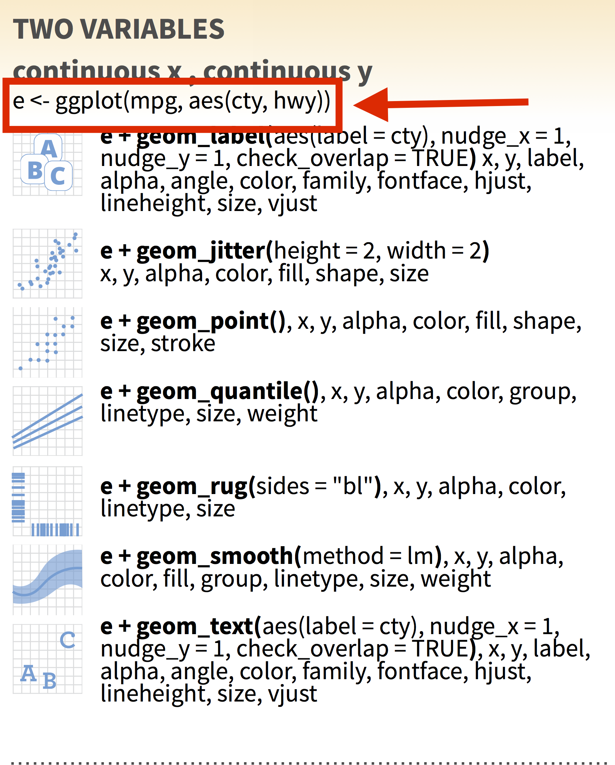
Using the ggplot2 cheat sheet
The cheat sheet reads like a choose your own adventure book
Based on your data, go to the One, Two or Three variables section.
If two variables decide if x and y are continuous.
Start your ggplot based on the example given under the heading

Slide 15
Using the ggplot2 cheat sheet
The cheat sheet reads like a choose your own adventure book
Based on your data, go to the One, Two or Three variables section.
If two variables decide if x and y are continuous.
Start your ggplot based on the example given under the heading
Add `geom_function` and additional aesthetic mapping as needed

Slide 16
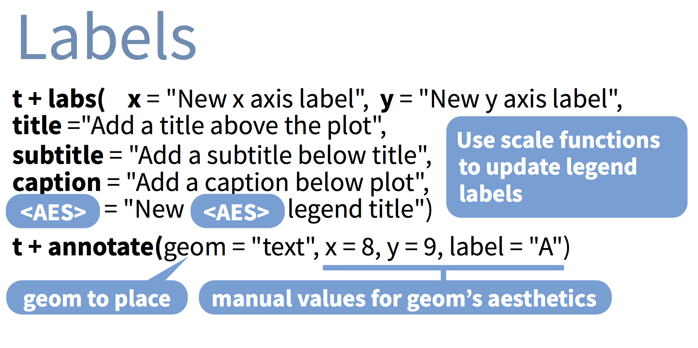
Using the ggplot2 cheat sheet
The cheat sheet reads like a choose your own adventure book
Based on your data, go to the One, Two or Three variables section.
If two variables decide if x and y are continuous.
Start your ggplot based on the example given under the heading
Add `geom_function` and additional aesthetic mapping as needed
Repeat last step until finished

Slide 17
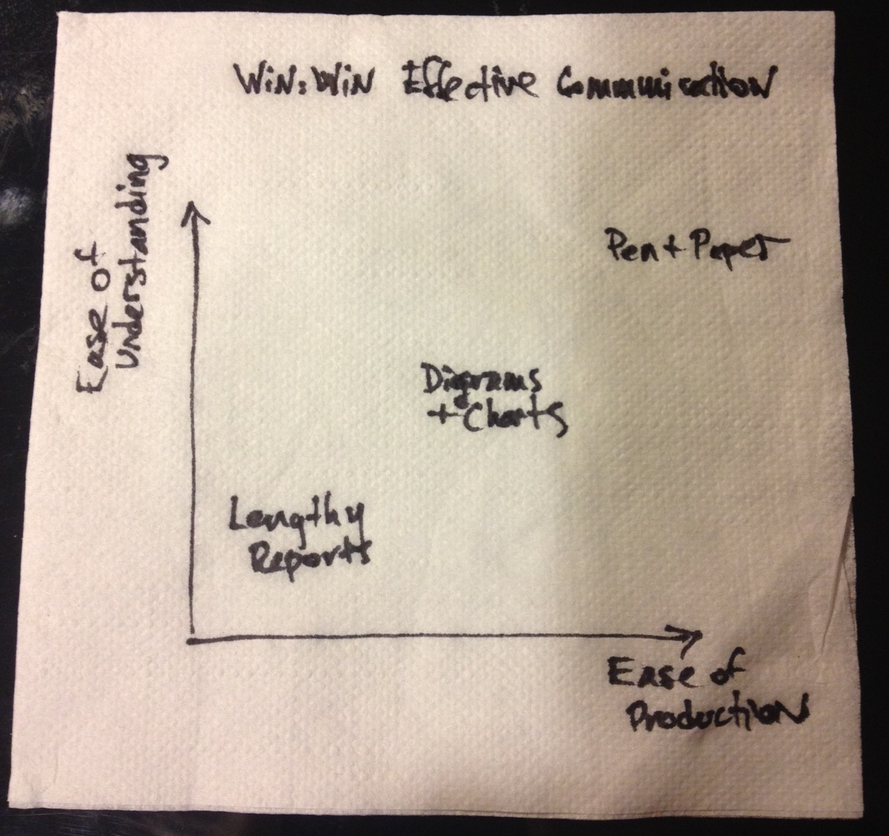
Plotting Challenge
Often, you'll have an idea of the visualization you'd like to make.
**But how to get there?**

Slide 18
Plotting Challenge
For the visualization exercises you'll work with the people sitting in your row.
Open `W4_Exercise\DataViz_X.html` with the number corresponding to your row.
Complete the 2 challenges as a group. (*this is a chance to practice starting a new project*)
Every group has the same 1st challenge, but different 2nd challenge
When you're finished, practice explaining your Challenge 2 code
We'll shuffle groups and explain the solutions to each other

Slide 19
Plotting Challenge
If you finish early, add more details to the plots or try exporting as a .png.

Slide 20
Plotting Challenge Debrief
**What were some of the interesting things you learned?**

Slide 21
BREAK
When you come back we'll be switching gears to inferential statistics

Slide 22
Inferential statistics
The branch of statistics that deals with hypothesis tests
`R` is much better for inferential statistics than other software
Why?

Slide 23
Strength of R for statistics
many of the common statistical analyses already exist as part of libraries
code based analysis means modifications to analysis are recorded
...The R community

Slide 24
We want to to ask:
You are tasked with *determining if butterfly infection prevalence is related to the region in which the butterflies were sampled and whether there are significant relationships with urbanization metrics*. There are many approaches that you could take, but start with the basic inferential statistics to ask:
Is the average monarch infection prevalence different between regions?
Is the prevalence associated with urbanization metrics?
Are any of the urbanization metrics correlated with each other?

Slide 25
We want to to ask:
You are tasked with *determining if butterfly infection prevalence is related to the region in which the butterflies were sampled and whether there are significant relationships with urbanization metrics*.
Tests:
T-tests `t.test()`
Linear regressions `lm()`
Correlation `cor.test()`
Start by opening `W4_Exercise\W4_Exercise.Rproj

Slide 26
We want to compare regions to ask:
**Test**
T-tests `t.test()`
Linear regressions `lm()`
Correlation `cor.test()`
**Result**
the means differ

Slide 27
We want to compare regions to ask:
**Test**
T-tests `t.test()`
Linear regressions `lm()`
Correlation `cor.test()`
**Result**
the means differ
some are strongly, positively correlated

Slide 28
We want to compare regions to ask:
**Test**
T-tests `t.test()`
Linear regressions `lm()`
Correlation `cor.test()`
**Result**
the means differ
relationships between infection and urbanization
some are strongly, positively correlated

Slide 29
Coding Workshops Wrap Up: We can ...
calculate summary statistics of a dataset
create a figure from data
create an HTML doc with code and commentary
write code following best practices
write a function
iterate a calculations
simulate populations
customize figures
code basic inferential statistics

